Slide 1
Setshabelo Admission System
Phase 3: System Development, Implementation and Final Demonstration
Group 0: Secret Design | ITC327W Work-Integrated Learning
Relebohile Thito · Lebohang Molise · Tshepo M Masimong · Lonwabo Sifumba · Andries M Matona · Njabulo R.A Mthethwa
Notes:
(about 1 minute) Greet the panel and introduce the group. Say that this presentation covers Phase 3: the working prototype of the Setshabelo Admission System, a digital admission system for Setshabelo Primary School in Welkom, Free State. Explain that the slides give the background and the design, and that we will run the Flutter and ASP.NET applications live next to the slides, so there are no screenshots here. Mention that all six members will speak and can answer questions on the whole system.

Slide 2
What we will cover
1
Problem, solution and recap of Phases 1 and 2
Stakeholder problem, scope, project journey, requirements and design
2
Architecture and shared Supabase backend
Roles, data model, authentication and storage
3
The two applications
Flutter and ASP.NET functions. Demonstrate both applications
4
Decisions, limitations and status
Risks, changes, status against requirements, next steps
Project Evidence
5
Github repositories, Supabase table, MS Project, Progress Tracker, Signed Prototype confirmation
Notes:
(about 1 minute) Walk through the five parts. Explain the order follows the assessment brief: we start with the stakeholder problem and approved solution, then show the shared Supabase backend and how the two apps use it, then run each app, then run the shared processes where both apps work with the same data. We close with our decisions, the limitations, and the current project status. The live demo parts are marked on the slides.

Slide 3
Section 1
Phase 1 and 2 recap
Stakeholder problem, project scope and requirements

Slide 4



The problem we were asked to solve
Current process at Setshabelo Primary School, Welkom
1
2
3
4
5
Application period announced on social media or verbally
Parents travel to school and join long queues
Paper forms collected and filled in by hand
Admin staff pile up and process papers manually
Outcomes shared on social media
Parents
Admin staff
The school
Time off work or transport to the school
Long queues in the application window
Hand-filled forms often wrongly completed
Many papers to process at once
Decisions made by reviewing each form manually
Missing information found late
Relies on social media for updates
Not every parent has access
Achievements not easily shared with the public
Notes:
(about 1.5 minutes) Describe the stakeholder: Setshabelo Primary School in Welkom, Free State, with stakeholder contact Disebo Tau. Today the school uses onsite paper registration at the start of each year. Walk through the five steps along the top, condensed from the nine-step current process in section 6 of the SRS. Then explain the impact on three groups: parents lose time and queue, admin staff process piles of paper and find errors late, and the school depends on social media, which excludes parents without access and gives no easy way to showcase achievements.

Slide 5
Our solution and its objectives
Aim Develop an integrated prototype for creating and managing learner applications and school updates: a Flutter mobile app and an ASP.NET web app that share one Supabase backend.
Parents apply online
Admins decide
Create an account, apply for a child, upload documents and track the status
Review applications, accept or reject, and leave comments for parents
Admins publish
Everyone stays informed
School updates and achievements shared with parents and the public
Parents view updates and achievements on mobile or web
Acceptance criteria Flutter and ASP.NET share the same backend. Users can perform the same actions on mobile and web.
Notes:
(about 1 minute) State the aim and the four objectives from the SRS. Stress the two acceptance criteria because we demonstrate both today: the apps share one backend, and users can do the same actions on both platforms. Mention that the deliverable is one integrated system, not two separate apps.

Slide 6
Scope decisions and feasibility
What we removed, and why
Feasibility result: feasible with changes
Bulk SMS
Too complex for one semester
Technical
With changes
Learn Supabase early
Operational
Feasible
Simple UI, little training
Uniform shop
School already partners with Atlas
Economic
Feasible
Free tiers are enough
E-textbooks
Online distribution raises copyright issues
Schedule
With changes
Start integration early
Kept: account creation, applications, status tracking, admin decisions, updates, achievements and role separation. The stakeholder was informed of every change.
Legal
Feasible
Test data, no secrets in GitHub
Ethical
Feasible
Only necessary data collected
Notes:
(about 1 minute) Explain the feasibility analysis from Unit 2. Technical and schedule feasibility needed changes because the group had to learn Supabase integration and time was tight. The three removed features were agreed with the stakeholder: bulk SMS was too complex for the semester, the uniform shop would clash with an existing partnership with Atlas, and distributing e-textbooks online raises copyright problems. This protected the core functions that matter most to the stakeholder.

Slide 7
How the project progressed
31 Aug 2026
16 Sep 2026
25 Sep 2026
2 Oct 2026
Oct 2026
Phase 1 · SRS v2.0
Stakeholder · Design feedback
Phase 2 · SRS v3.0
Phase 2 · Presentation
Phase 3 · Build
Requirements, feasibility, risk register, SWOT
Wireframes approved, emblem background removed
Architecture, UML, ERD, Figma designs
Design presented, risk register refined
Supabase backend, both apps, integration
Top risks in the final risk register
R1 Integration too hard
R6 Core functions late
R3 Group coordination
Score 9
Score 9
Score 6
Research Supabase early, consult the lecturer if stuck
Implement the top-level functions first
Regular team meetings, reassign tasks when needed
Notes:
(about 1.5 minutes) Show how the work progressed across the three phases. Phase 1 produced SRS v2.0 on 31 August with requirements, feasibility and the first risk register. On 16 September the stakeholder approved the Flutter wireframes; the only change was removing the emblem as a background. SRS v3.0 on 25 September added the architecture, use cases, sequence diagrams, ERD and Figma designs, and the Phase 2 presentation on 2 October refined the risk register. Phase 3 is the build. The three highest risks were integration difficulty, delivering core functions on time, and group coordination, and we tackled each with the planned mitigation.

Slide 8
Recap of Phase 1: requirements and analysis
8
4
4
4
Functional requirements
Non-functional kept
System requirements
Integration requirements
All must have
NR1 to NR4
ASP.NET, Flutter, Supabase, browsers
Shared backend and Auth
Analysis we completed
SWOT highlights
Six-factor feasibility: technical, operational, economic, schedule, legal and ethical
13 risks scored by likelihood and impact
Critical risks: limited testing time, late core functions, date projections
Scope refined with the stakeholder
Strength Engaged stakeholder; free tools; core features match real pain points
Weakness Supabase was a new skill; tight testing window
Opportunity Achievements page doubles as marketing; reusable for other schools
Threat Supabase downtime; some parents lack digital access
Notes:
(about 1.5 minutes) RECAP OF PHASE 1, presented on 31 August with SRS v2.0. Remind the panel of what was agreed: eight functional requirements, four kept non-functional requirements (similar interface, admin-only decisions, test data and clear validation messages), four system requirements fixing ASP.NET, Flutter and Supabase, and four integration requirements. Then summarise the analysis: six feasibility factors, a scored risk register and a SWOT analysis. The three critical risks at that stage were limited testing time, core functions arriving late and inaccurate date projections. This phase gave us the baseline the build is measured against.

Slide 9



Recap of Phase 2: system design
Architecture
Use cases
Flutter app with MVVM for parents
ASP.NET web app with MVC for admins
Supabase Auth, database and storage in the middle
Parent: 7 use cases, from account to viewing updates
Administrator: 4 use cases: account, login, review, publish
Submit includes validation; decisions extend review
Sequence diagrams
ERD and design
Parent submits: Flutter, Auth, database, storage
Admin reviews: ASP.NET, Auth, database updated
Both flows share the same Supabase data
ERD with 8 entities and keys
Figma designs for the Flutter app and the web pages
Stakeholder feedback on 16 September, design confirmation letter signed
Notes:
(about 1.5 minutes) RECAP OF PHASE 2, presented on 2 October with SRS v3.0. The design phase turned the requirements into a plan. The architecture was fixed: Flutter with MVVM, ASP.NET with MVC, and Supabase for authentication, data and files. The use case diagram showed what parents and administrators do; the parent had seven use cases and the administrator four, and the diagram showed that submitting an application always includes validation, while accepting or rejecting extends the review. Two sequence diagrams described the parent submitting an application and the admin reviewing it. The ERD defined the eight entities and keys, and the Figma designs were approved by the stakeholder on 16 September. Phase 3 builds exactly this design, with the changes we explain later.

Slide 10
Section 2
Architecture and shared Backend Supabase
Roles, data model, authentication and storage

Slide 11


System architecture
Supabase
Auth
Sign up, sign in, roles
Flutter mobile app
ASP.NET web app
Used by parents
MVVM pattern with Provider
Supabase client library
Database
8 shared tables
Used by admins and parents
MVC pattern with role-based access
Supabase REST and Auth
Storage
Documents and images
IR1
The apps never talk to each other directly
IR4
Both use the same Supabase Auth
SR3
One shared backend for all data
Notes:
(about 1.5 minutes) Explain the architecture. Supabase sits in the middle and provides three services: authentication, the Postgres database and file storage. The Flutter mobile app is used by parents and follows the MVVM pattern. The ASP.NET web app is used by admins and also supports parents, and follows the MVC pattern. The key integration rules from the SRS are on the bottom: the two apps never talk to each other directly (IR1), both use the same Supabase Auth (IR4), and all data lives in one shared backend (SR3). Everything one app writes, the other can read.

Slide 12


Users, roles and permissions
Parent
Admin
SuperAdmin
Flutter and web
ASP.NET web
ASP.NET web
Create an account and log in
Apply for a child through a multi-step form
Upload supporting documents
Track status and read admin comments
View school updates and achievements
Edit their own profile
Log in to the admin area
See all applications with search and filter
Review details and documents
Set status and add comments
Publish updates and achievements
Manage published content
Has all admin abilities
Registers new admin accounts
Keeps admin creation out of the public sign-up
Notes:
(about 1 minute) Explain how users are separated. A role value is stored for each user in the profiles table: Parent, Admin or SuperAdmin. When someone signs in on the web app, their role decides which pages they can reach; admin pages reject parents, and parent pages reject admins. This meets FR7 and NR2: the system differentiates users and admins, and only authenticated admins can accept or reject applications. A SuperAdmin role was added during implementation so that admin accounts can only be created by a trusted user rather than through public registration.

Slide 13
The shared data model
parents
parent_id, user_id, names
applications
child and parent details, status, dates
documents
type, file link
comments
comment text, admin
One profile per user. A parent creates many applications. Each application has documents and admin comments. Admins publish updates and achievements.
profiles
id, email, role
school_updates
title, content
admins
admin_id, user_id, names
achievements
title, text, image
Notes:
(about 1.5 minutes) This is the approved ERD from Phase 2, implemented in Supabase. Start on the left: every user has one profile with a role. A profile links to a parent record or an admin record. A parent creates many applications. Each application can have many documents and many admin comments. Admins publish school updates and achievements, so those tables store the admin who published them. Primary keys and foreign keys follow the ERD, so each table links to the right record. Mention that file storage is separate: documents keep a link to the file in Supabase Storage. If the panel asks, open the Supabase table editor to show the tables.

Slide 14
Authentication, storage and security
Authentication
Storage
Security and privacy
Both apps use the same Supabase Auth
Sign-up also creates the profile and parent records
Web keeps the login in a secure session cookie with the role
Flutter keeps the Supabase session and checks the role at login
application_documents for parent uploads
achievement_images for admin photos
The database stores the link to each file
Admins open documents from the application
Keys are not stored in GitHub
The powerful service key is used only on the web server
Parents are shown only their own applications
Only test data and fake profiles are used
Notes:
(about 1 minute) Cover the three supporting services. Authentication: both apps register and sign in users with the same Supabase Auth, which meets IR4. On sign-up a profile row and a parent row are created. Storage: parents' supporting documents go into the application_documents bucket and admin photos into achievement_images; the database keeps the link. Security: the keys are not in GitHub, as the legal feasibility section requires, and the privileged service key is only used on the server side of the web app. Parents are shown their own applications by their parent ID, and the project uses test data only, as NR3 requires. Be ready to say that stricter database-level policies could be added as future work.

Slide 15
Section 1
Application Functions and Demonstration
Demonstrate the integrated system

Slide 16
Flutter mobile app
LIVE DEMO
What parents can do
Screen flow
Register and log in
Apply through a six-step form: parent, child, education, contact, medical, documents
Upload supporting documents
See every application with its status
Read admin comments on an application
Read school updates and awards
Edit their profile
Login or Register
Home
Apply (6 steps)
Updates
Home also leads to Updates, Awards and Profile
My Applications
Awards
Application details
Profile
Notes:
(about 3 minutes including the live demo) Briefly describe the app, then SWITCH TO THE LIVE FLUTTER APP. Demo path with a test parent: show the login and create-account screen; log in and show the home dashboard; start a new application and go through the six steps, showing the validation messages; open My Applications to show each child's status; open an application to show the status and any admin comments; show Updates, Awards and Profile. The app follows MVVM: screens are the views, a view model holds state with Provider, models describe the data and a service class talks to Supabase. Use dummy data only.

Slide 17
ASP.NET web app
LIVE DEMO
What admins can do
Page flow
Log in with the Admin role
See dashboard totals by status
Search and filter all applications
Open details and documents
Set status and add comments
Publish updates and achievements
Edit or delete content, and register admins as SuperAdmin
Login
Dashboard
Applications
Manage Content
Application detail
Set status
Add comment
Publish Update
Publish Achievement
Notes:
(about 3 minutes including the live demo) Briefly describe the web app, then SWITCH TO THE LIVE WEB APP. Demo path with a test admin: log in; show the dashboard counts; open Applications and use search and the status filter; open one application to show child and parent details and documents; show the status and comment controls; open Publish Update and Publish Achievement; open Manage Content to view, edit or delete items. Mention that parents can also register and apply on the web app, so it supports the same parent actions as Flutter. The app follows MVC with controllers for account, parent, admin, content and super admin actions, and one service that talks to Supabase.

Slide 18
Section 5
Project status and decisions
Discuss key decisions taken during implementation, risks changes to the project and the status of the project

Slide 19

Key implementation decisions
Supabase as the only integration point
Roles in the profiles table
MVVM and MVC
No custom API between the apps. Both use the same project, which is what IR1 to IR4 require.
One place decides what Parent, Admin and SuperAdmin can reach, checked on the server.
Each app follows the pattern that suits its platform, with matching models and table names.
Six-step application form
Files in storage, links in the database
Secrets kept out of GitHub
Splitting the form into steps and validating each step reduces wrongly filled forms (NR4).
Documents and photos sit in storage buckets; tables hold only the links.
Keys are supplied locally and the web server holds the privileged key.
Notes:
(about 1.5 minutes) Be ready for questions on each decision. Why Supabase: it provides authentication, a database and storage in one free-tier service that both Flutter and ASP.NET can use. Why roles in profiles: one table holds the role for every user, so both apps can read it. Why MVVM and MVC: each follows the common pattern of its platform. Why six steps: smaller steps with validation help parents avoid mistakes, which was a core problem with paper forms. Files are kept in storage with links in the tables. Secrets are not in GitHub, in line with our legal feasibility decision.

Slide 20
Risks and how we managed them
R1
Integration may be too hard
Researched Supabase with Flutter and ASP.NET early; consult the lecturer with problems that occured
R3
Group coordination and miscommunication
Regular team meetings to share progress and setbacks; reassign tasks if needed
R4
Limited testing time near the deadline
Test with different data throughout development, not only at the end
R5
A task too hard for one member
Delegate by strongest skills; spread the work across members
R6
Core functions not ready in time
Build the top-level functions first, then enhancements
R7
GitHub version control problems
Each member commits their own tasks which are regularly tested by other members
Notes:
(about 1.5 minutes) Link back to the risk register in the SRS. Pick two or three examples the group can speak about from experience, for example how the group learned Supabase integration early (R1), and how work was divided so core functions were built first (R6). Say how the plan helped and, honestly, where it was hard, such as tight testing time. Note that the register and mitigation plans are in sections 17 and 18 of the SRS, and the Microsoft Project schedule and progress tracker record the actual progress.

Slide 21
Changes and known limitations
Changes made during implementation
Known limitations
A SuperAdmin role was added so only the team can register admins
Side navigation was changed
Admin work is done only on the web app, not on mobile
No push notifications: parents see new statuses after refreshing
Parents cannot cancel an application
School updates can be deleted but not edited
Bulk SMS, uniform shop and e-textbooks are excluded by agreement
Prototype uses dummy data only
Stricter database-level access rules are future work
Notes:
(about 1.5 minutes) The brief asks us to record incomplete functions and limitations accurately, so be direct. Changes: the form moved to six steps with a separate education step; a SuperAdmin role was added; parents can also use the web app; admin work is web only. Limitations: statuses are seen on refresh because there are no push notifications; cancelling an application appeared in the Phase 2 presentation but is not implemented; school updates can be deleted but not edited; and the excluded features remain out of scope. Add anything else the group knows is incomplete before presenting.

Slide 22
Project status against requirements
ID | Requirement | Where | Status
FR1 | Parents create accounts | Flutter, web | Working
FR2 | Parents create applications | Flutter, web | Working
FR3 | Parents view status | Flutter, web | Working
FR4 | Only admins accept or reject | Web, Admin role | Working
FR5, FR6 | View updates and achievements | Flutter, web | Working
FR7 | Differentiate users and admins | Roles in profiles | Working
FR8 | Admins publish updates | Web | Working
IR1 to IR4 | One backend, same Auth, no direct links | Both apps | Working
Notes:
(about 1.5 minutes) Show the current status. All eight functional requirements and the four integration requirements are implemented across the two apps; the exceptions are the limitations on the previous slide. On the right, mention the project records: the final SRS, the GitHub repositories under WIL-Project-Hub, the updated Microsoft Project schedule, the Excel tracker with the group reflection, and the Supabase project. Confirm every row in a rehearsal and change a row to Incomplete if a function does not run on the day.

Slide 23
Conclusion and future work
What we achieved
Possible next steps
A working Flutter app, ASP.NET app and shared Supabase backend
Parents can apply, upload documents and track their application without visiting the school
Admins can decide, comment and publish from one place
Three shared processes show the apps working on the same data
Scope was managed with the stakeholder from Phase 1 to Phase 3
Real-time updates and push notifications
Cancel an application and edit school updates
Database-level access rules for stronger security
Revisit excluded features
Reuse the architecture for other projects with the same problem
Notes:
(about 1 minute) Summarise what the group achieved against the original problem: parents no longer need to queue or fill in paper forms, admins can decide and communicate from one place, and the school can publish updates and achievements. Then give the next steps from the SRS: real-time notifications were marked to monitor in the schedule feasibility, the excluded features could return in a later phase, and the architecture is reusable for other schools, which was listed as an opportunity in the SWOT analysis.

Slide 24
Section 5
Project Evidence

Slide 25
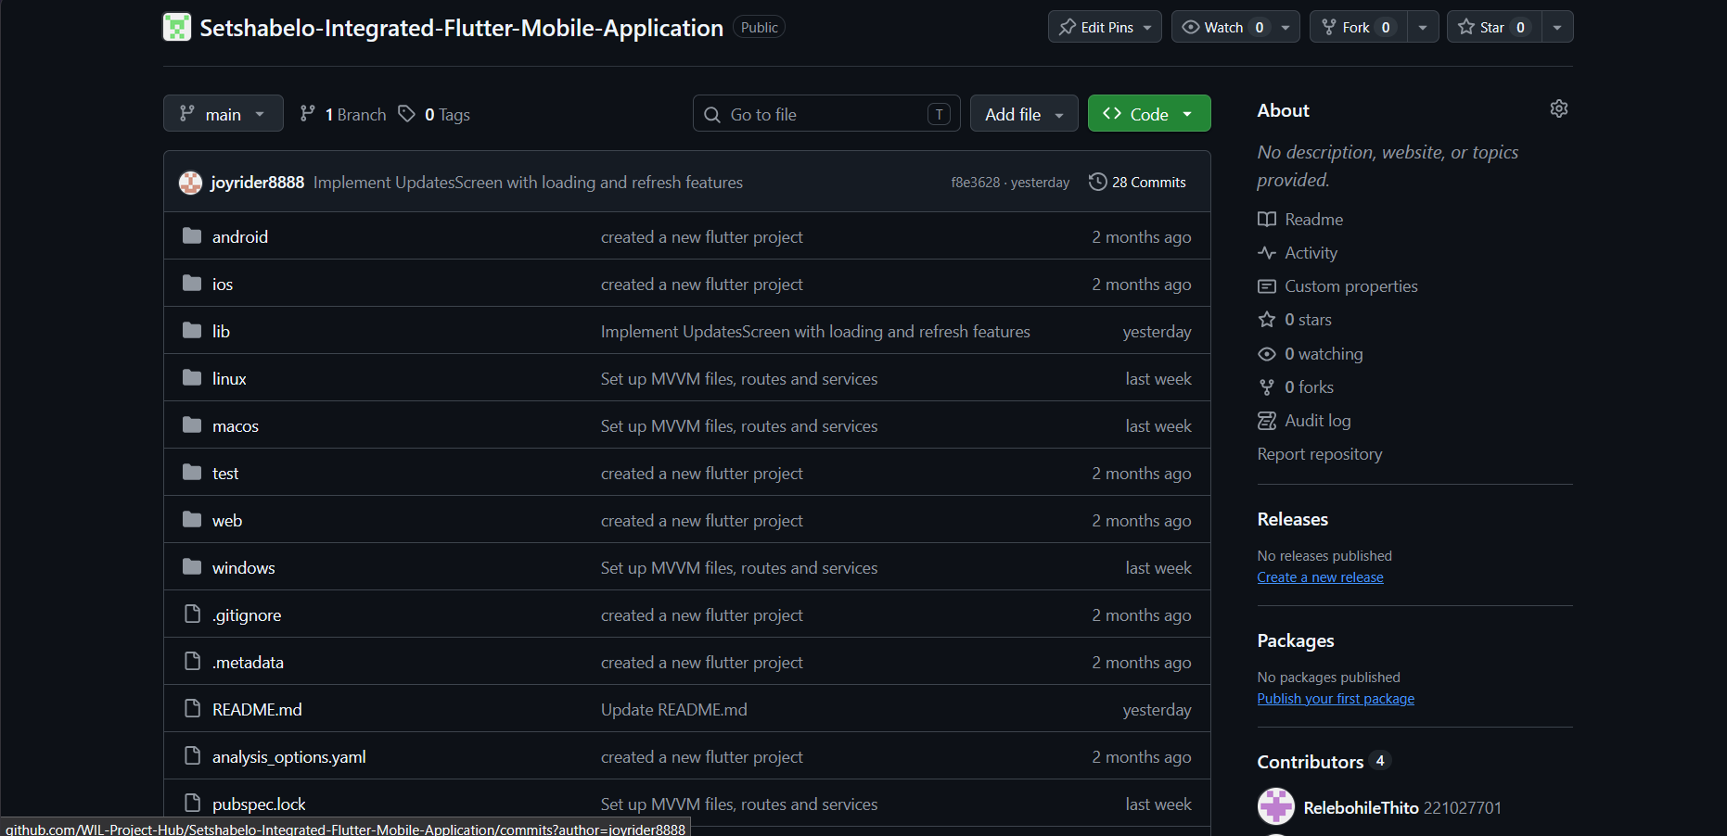
Project Evidence
Strategic Tools - GitHub
Flutter mobile application github repository: https://github.com/WIL-Project-Hub/Setshabelo-Integrated-Flutter-Mobile-Application

Slide 26
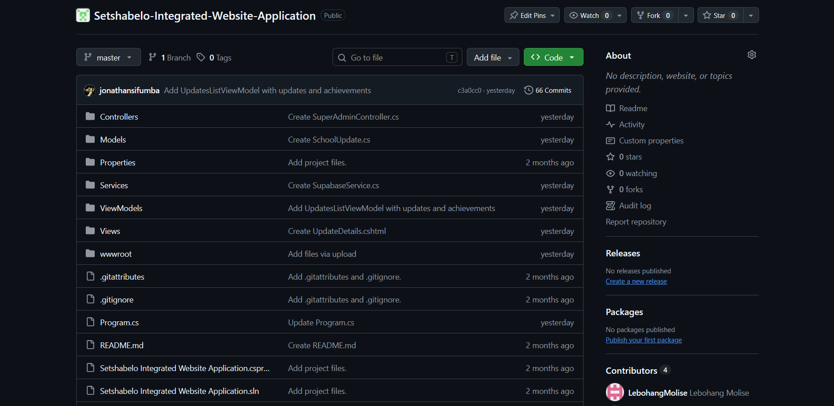
Project Evidence
Strategic Tools - GitHub
ASP.NET web application github repository: https://github.com/WIL-Project-Hub/Setshabelo-Integrated-Website-Application

Slide 27
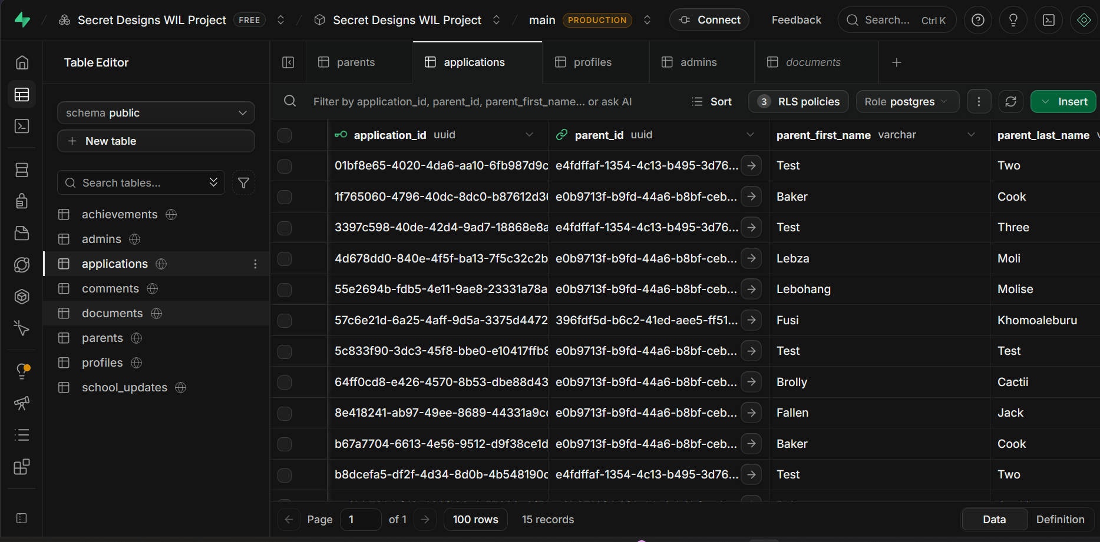
Project Evidence
Strategic Tools – Supabase

Slide 28
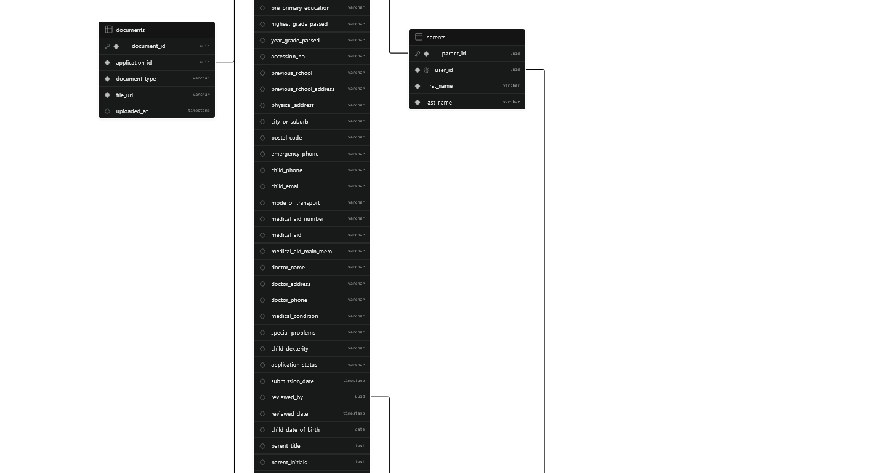
Project Evidence
Strategic Tools – Supabase schema

Slide 29
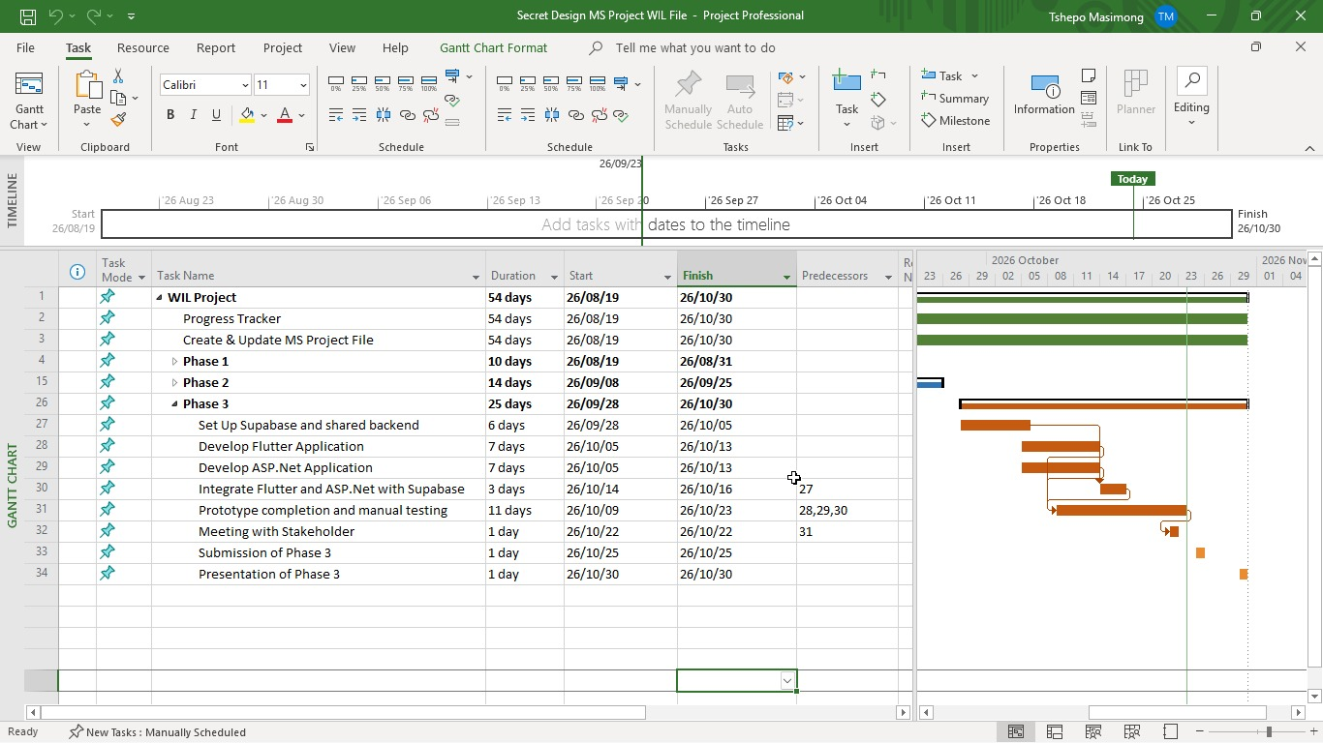
Project Evidence
Strategic Tools – Microsoft Project

Slide 30
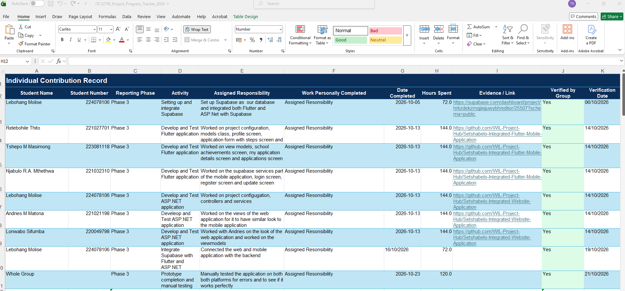
Project Evidence
Strategic Tools – Progress Tracker

Slide 31
Project Evidence
Prototype Acceptance

Slide 32
Thank you
Setshabelo Admission System
Group 0: Secret Design
Relebohile Thito
Lebohang Molise
Tshepo M Masimong
Njabulo R.A Mthethwa
Andries M Matona
Lonwabo Sifumba
Notes:
Thank the panel and invite questions. Every member should be ready to answer questions about the whole system and about their own contribution. Keep the live apps open and ready to show anything the panel asks for.

